Slide 1

Building Blocks:
Cholesterol and Your Body
From the American Heart Association
Locally Sponsored by

Slide 2
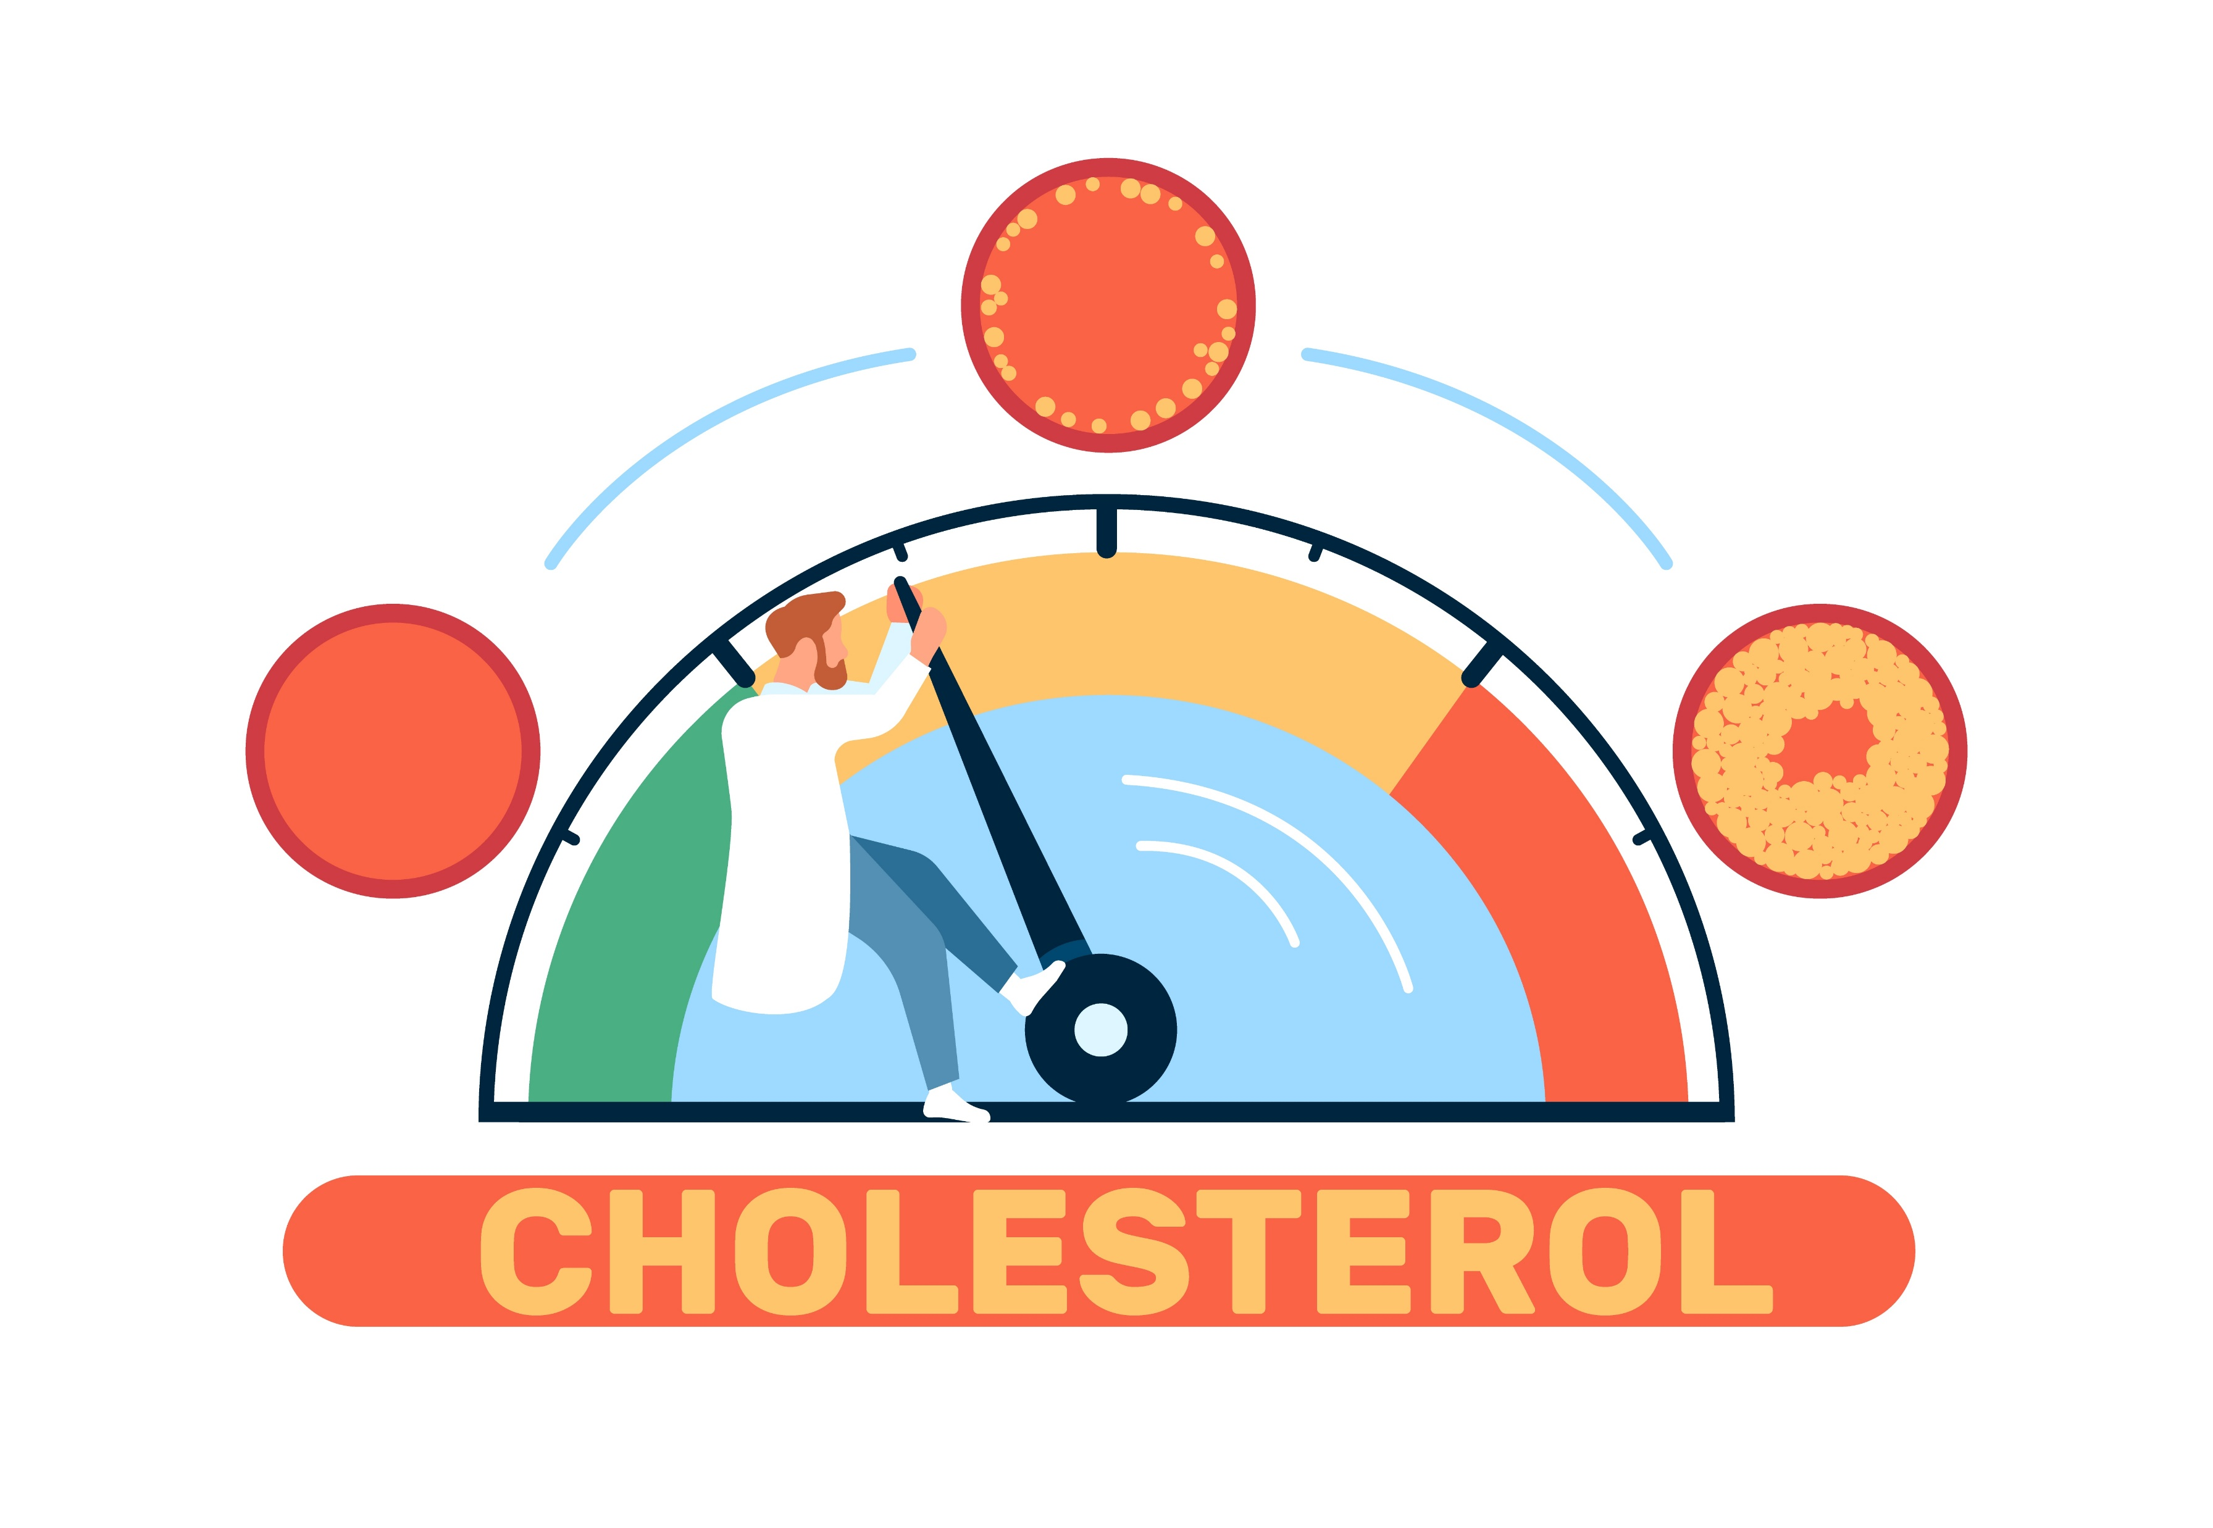
What is Cholesterol?
Cholesterol is a fat-like substance that comes from two sources: food and your body.
It is only found in foods from animal sources.
Notes:
SOURCE
https://www.heart.org/en/healthy-living/healthy-lifestyle/lifes-essential-8/how-to-control-cholesterol-fact-sheet

Slide 3
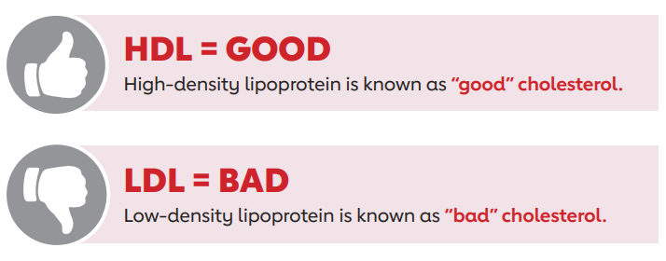
Why Is Controlling Cholesterol Important?
High cholesterol can affect your heart and brain health. It can lead to heart disease.
It can also increase the risk of some types of dementia, like Alzheimer’s disease.
There are two types of cholesterol: HDL and LDL. HDL helps keep LDL from sticking to artery walls. This reduces plaque buildup and lowers the risk of heart disease and stroke.
Notes:
SOURCE
https://www.heart.org/en/healthy-living/healthy-lifestyle/lifes-essential-8/how-to-control-cholesterol-fact-sheet

Slide 4
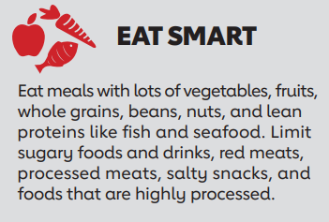
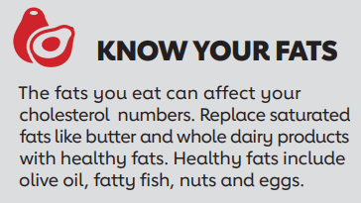
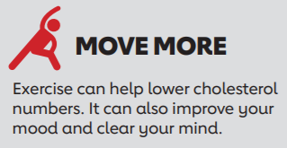
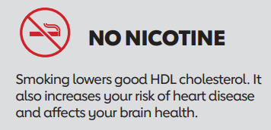
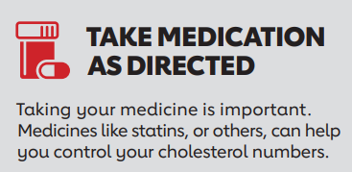
How to Control Cholesterol
Notes:
SOURCE
https://www.heart.org/en/healthy-living/healthy-lifestyle/lifes-essential-8/how-to-control-cholesterol-fact-sheet

Slide 5


How to Talk to Kids About Cholesterol
Cholesterol is a type of fat that travels through our blood to different parts of our body.
Our bodies make cholesterol, but we also get it from some of the foods we eat. It is found in food that comes from animals, like chicken or cheese.
Imagine cholesterol as little tiny workers that help build and repair our cells. Cells are the building blocks of our bodies. But just like with toys or treats, too much cholesterol isn’t good for us. It’s like having too many workers in one place and things start to get messy!
That’s why it’s so important we eat healthy foods to make sure we have healthy cholesterol! We can also have healthy cholesterol by being active and drinking water.
Notes:
SOURCE
https://www.heart.org/-/media/Healthy-Living-Files/LE8-Fact-Sheets/For-Kids/lifes_essential_8__for_kids_building_blocks.pdf?sc_lang=en

Slide 6
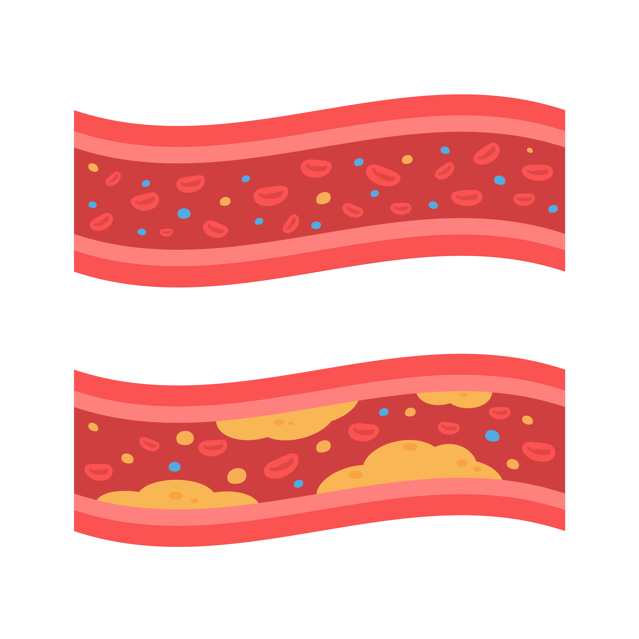
Cholesterol Levels in Kids
Children with high cholesterol are usually healthy and have no symptoms.
Screening is important! The only way to know if your child has high cholesterol is to be screened.
Talk to your pediatrician. Kids should have their cholesterol checked at least once between 9-11 years old and again between 17-21 years old.
Notes:
SOURCE
https://www.heart.org/-/media/Healthy-Living-Files/LE8-Fact-Sheets/For-Kids/lifes_essential_8__for_kids_building_blocks.pdf?sc_lang=en

Slide 7
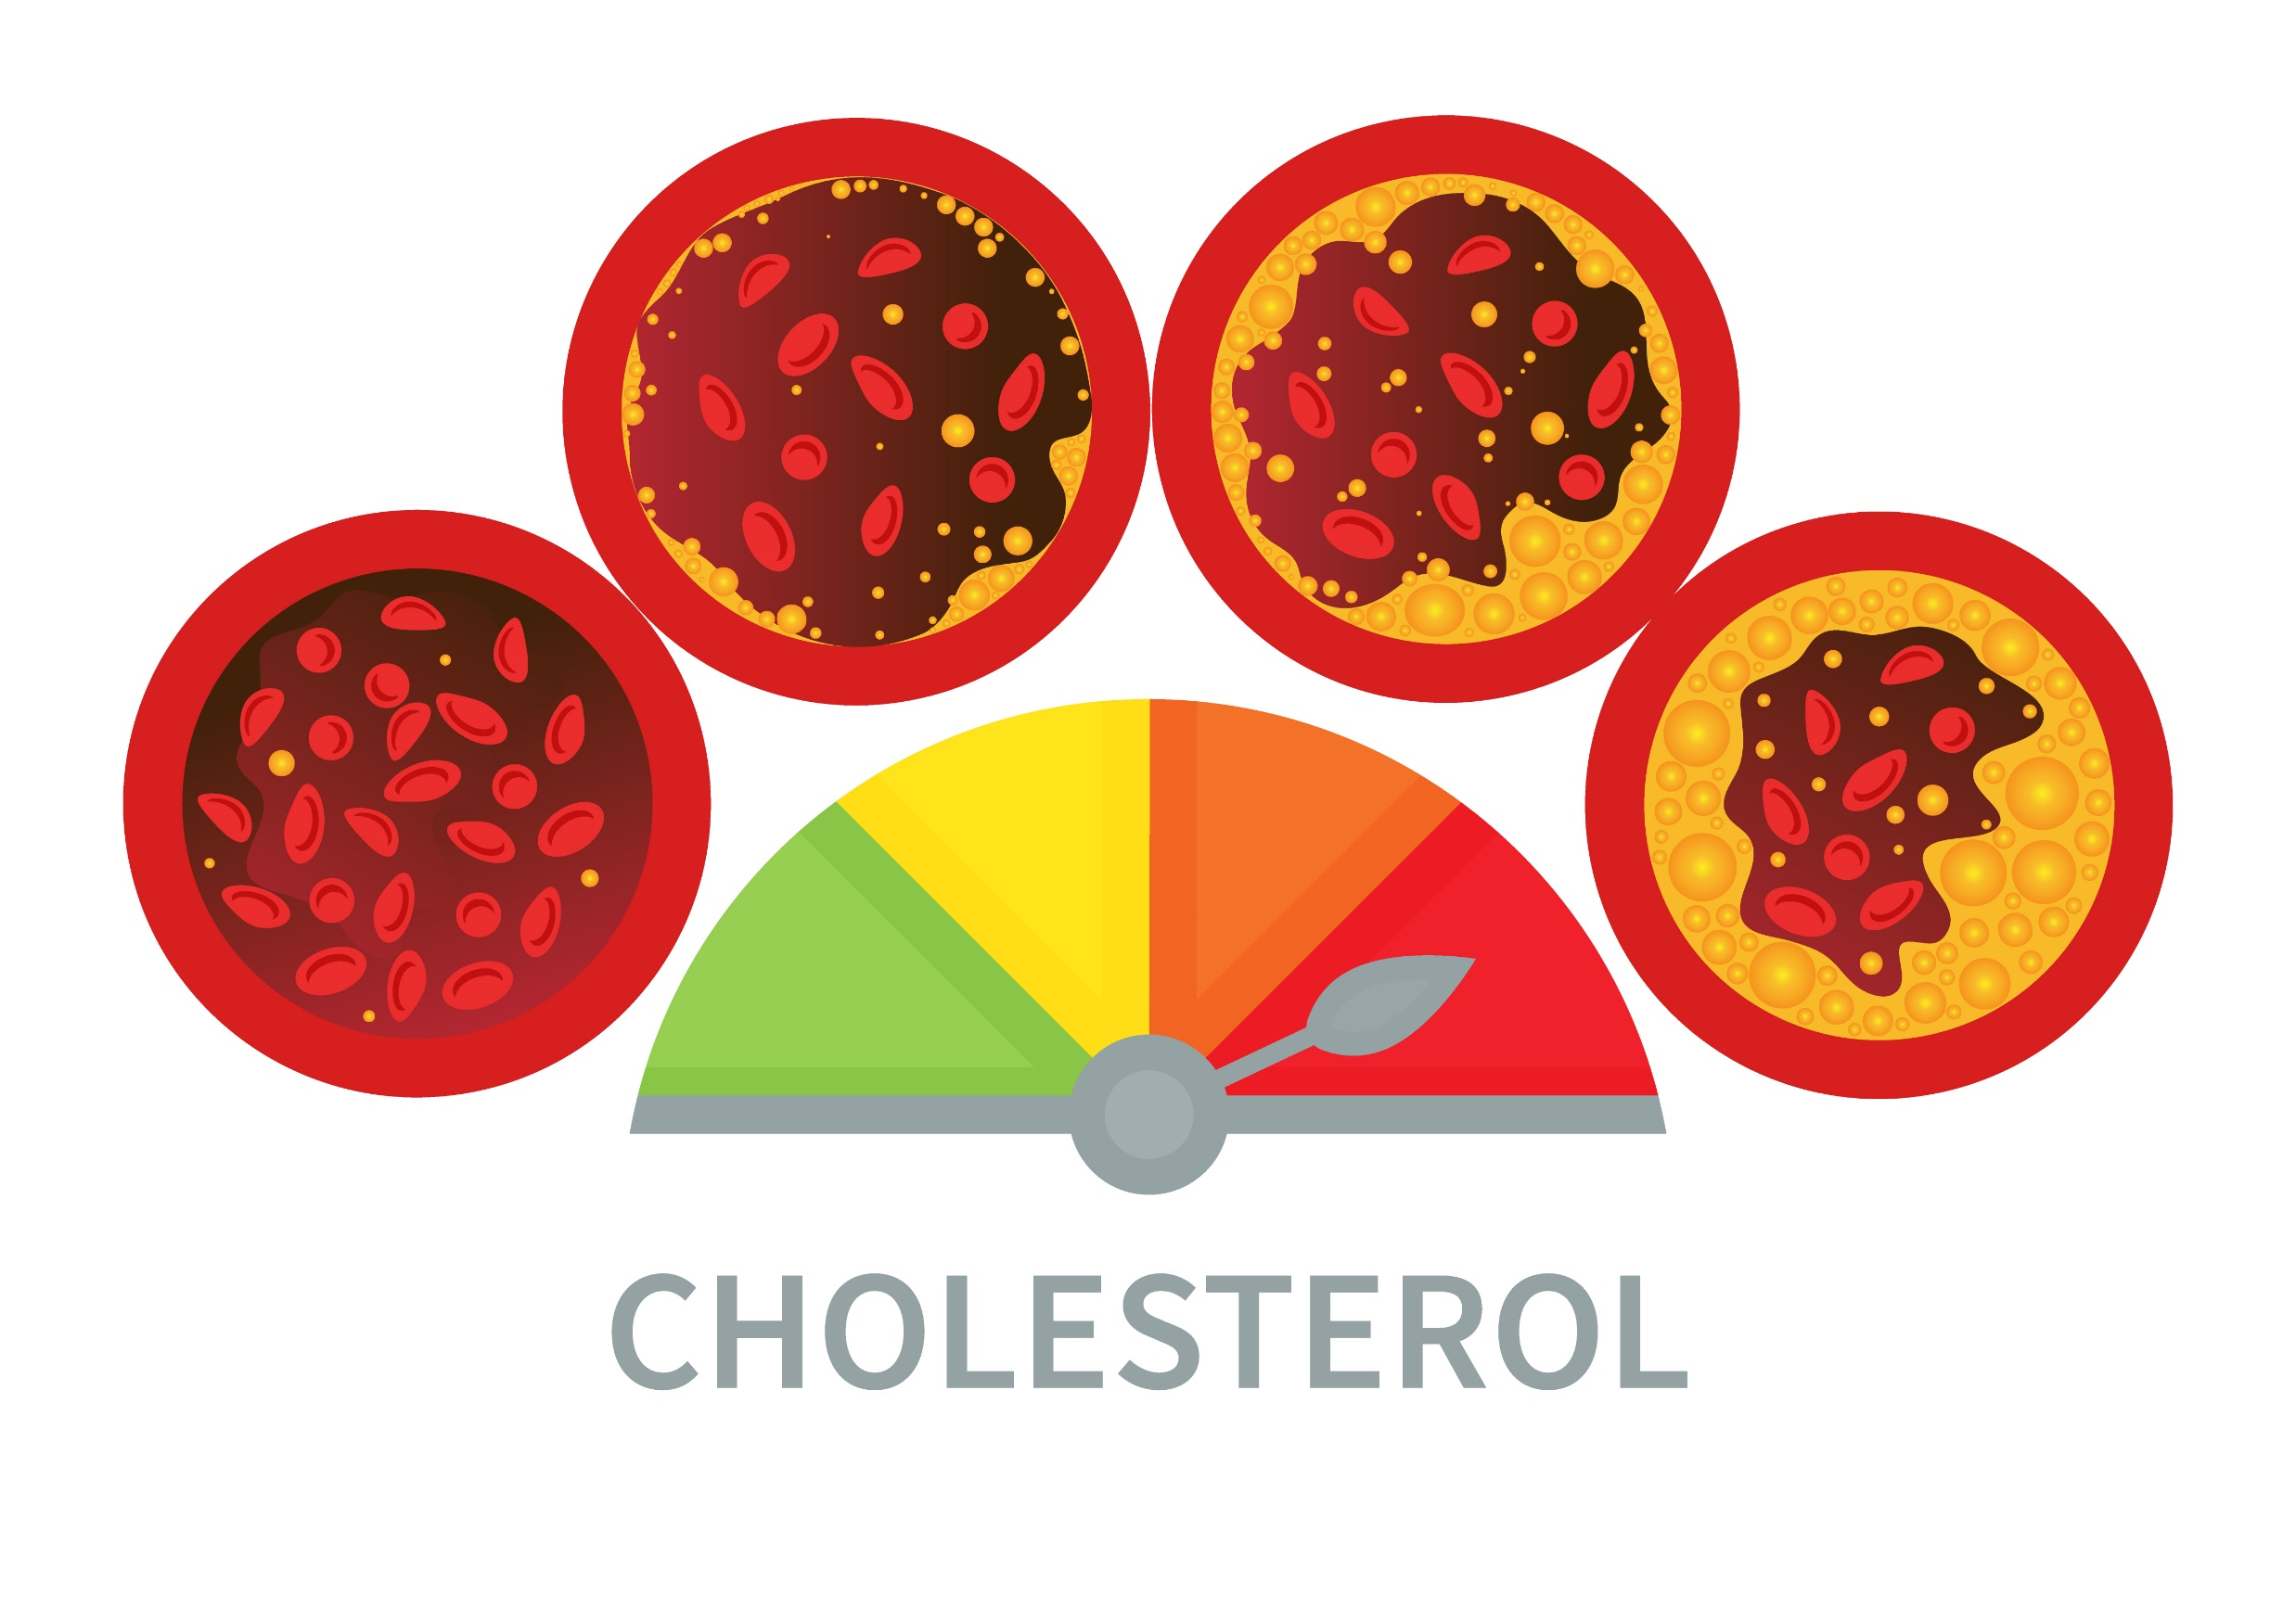
High Cholesterol Levels
If someone’s cholesterol levels are too high, a doctor might suggest medicine or changes in what they eat to help keep them in a healthy range.
Your pediatrician can help you create a plan for your child. Follow the plan and discuss any concerns you might have with them!
Notes:
SOURCE
https://www.heart.org/-/media/Healthy-Living-Files/LE8-Fact-Sheets/For-Kids/lifes_essential_8__for_kids_building_blocks.pdf?sc_lang=en

Slide 8

Familial Hypercholesterolemia
Medicine is usually needed if you have Familial Hypercholesterolemia (FH), which is when your body has a hard time recycling your LDL cholesterol.
FH is hereditary, meaning it is passed on to you from one or both parents.
Notes:
SOURCE
https://www.heart.org/-/media/Healthy-Living-Files/LE8-Fact-Sheets/For-Kids/lifes_essential_8__for_kids_building_blocks.pdf?sc_lang=en

Slide 9




What To Eat if You Have High Cholesterol
Fruits and vegetables
Whole grains
Fat-free and low-fat milk products or plant-based milk alternatives (oat, soy, or almond milk fortified with vitamins A and D)
Skinless poultry and lean meats
Fatty fish such as salmon, trout, albacore tuna and sardines
Beans, peas, lentils, quinoa, tofu, nuts and seeds
Nontropical vegetable oils like canola, corn, olive, or safflower oils
Notes:
SOURCE
https://www.heart.org/-/media/Files/Health-Topics/Answers-by-Heart/How-Can-I-Improve-Cholesterol.pdf

Slide 10
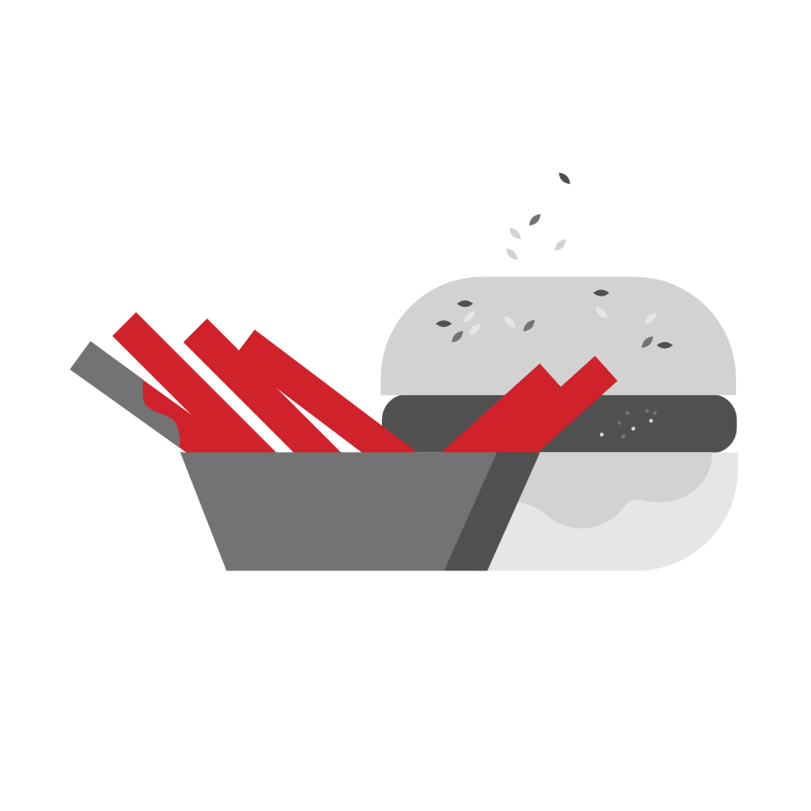

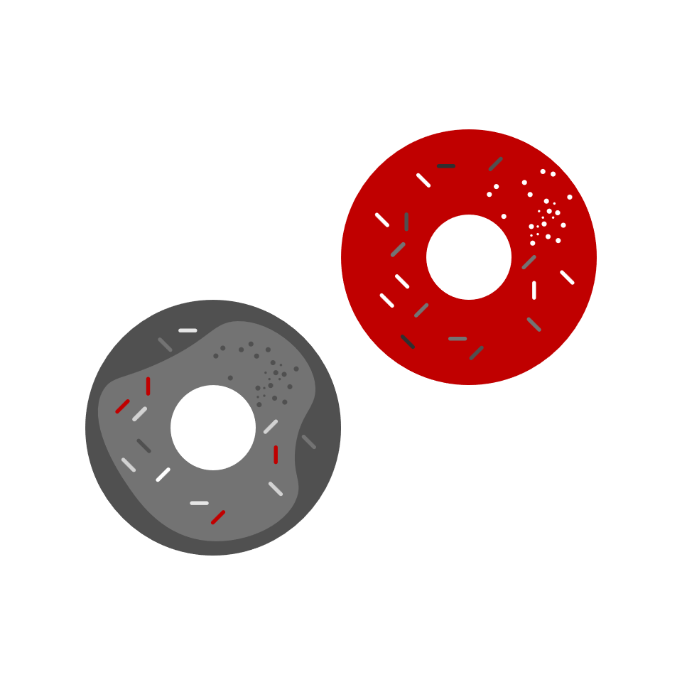
What To Avoid if You Have High Cholesterol
Foods with a lot of sodium (salt)
Sweets and sugar-sweetened beverages
Red meats and fatty meats that aren’t trimmed
Processed meats such as bologna, salami and sausage
Full-fat dairy products such as whole-milk, cream, ice cream, butter and cheese
Baked goods made with saturated and trans fats such as donuts, cakes and cookies
Foods that list the words “hydrogenated oils” in the ingredients panel
Tropical oils, which include palm and coconut oil
Solid fats such as butter, shortening, stick margarine and lard
Fried foods
Notes:
SOURCE
https://www.heart.org/-/media/Files/Health-Topics/Answers-by-Heart/How-Can-I-Improve-Cholesterol.pdf

Slide 11
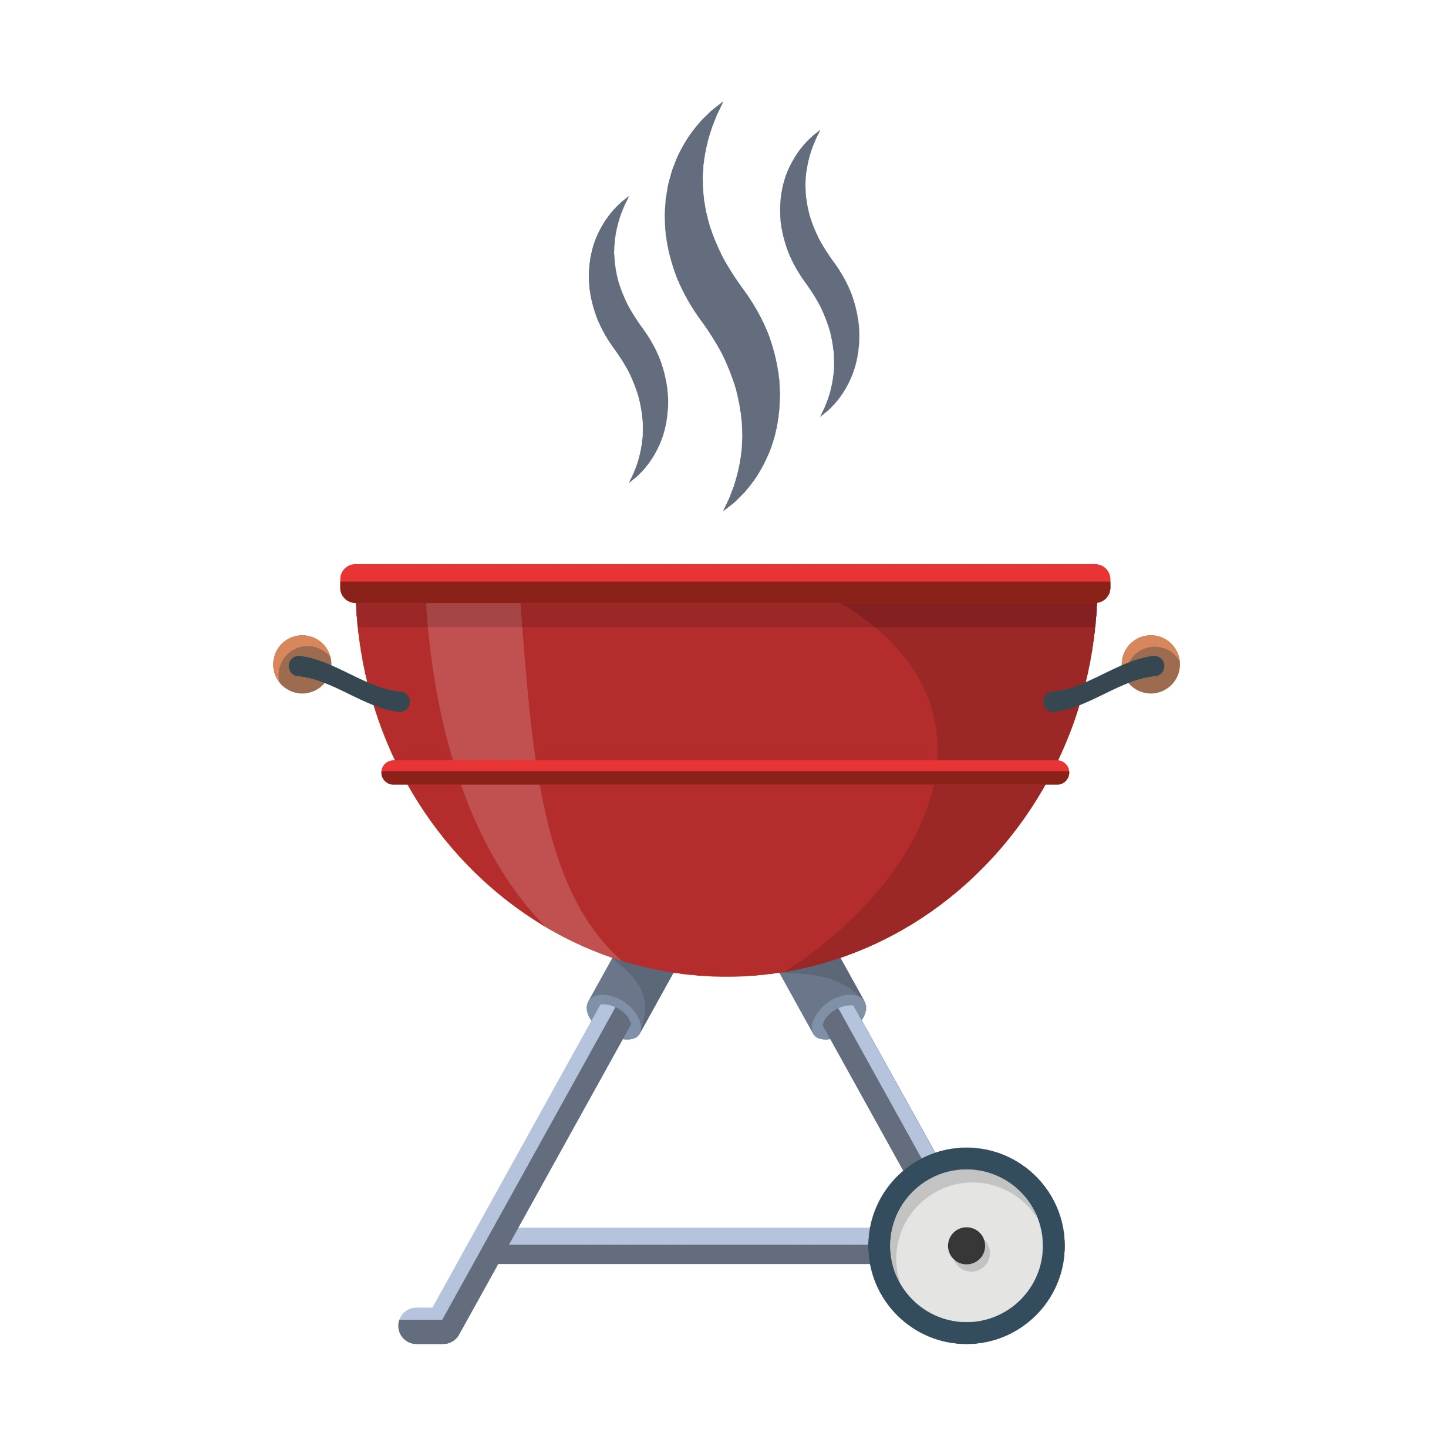

Cooking Tips
Look for leaner cuts if you choose to eat meat. For red meat and pork, select options labeled “loin” and “round.” These cuts usually have the least amount of fat.
Cut off all visible fat from meat before cooking.
Remove the skin from poultry.
Broil or grill instead of pan-frying.
Use a rack to drain off fat when you broil, roast or bake poultry and meats.
Use a vegetable oil spray to brown or sauté foods.
Use low-fat, low-sodium options instead of regular cheese.
REMEMBER
Eating healthy doesn’t mean giving up all the things you love!
Eat treats in moderation.
You can also serve smaller portions of higher-calorie dishes.
Notes:
SOURCE
https://www.heart.org/-/media/Files/Health-Topics/Answers-by-Heart/How-Can-I-Improve-Cholesterol.pdf

Slide 12
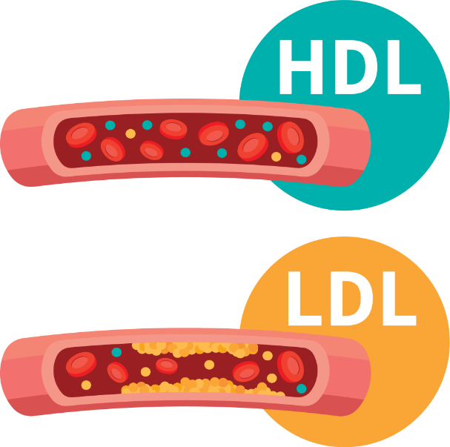
Wrap Up
Cholesterol is fat-like substance in our bodies that helps up build and repair cells.
But too much isn’t good for us – it can lead heart disease.
Know your numbers and work with your doctor on plan to manage your cholesterol. This could include a healthy diet, physical activity, and in some cases, medication.

